Slide 1
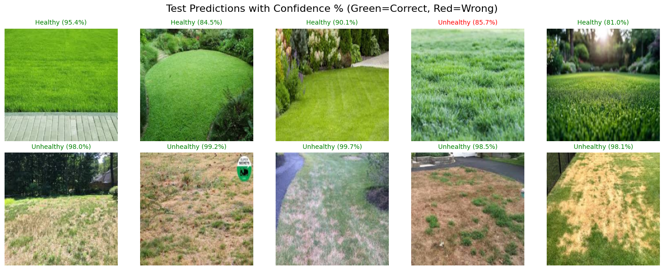
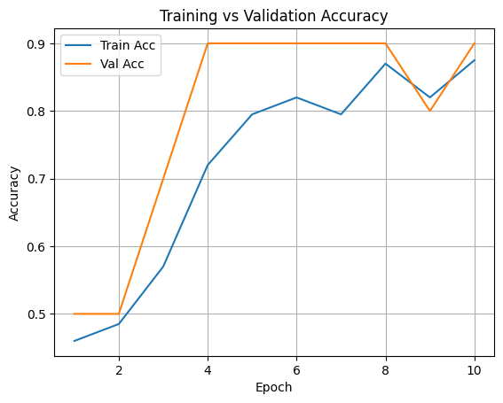
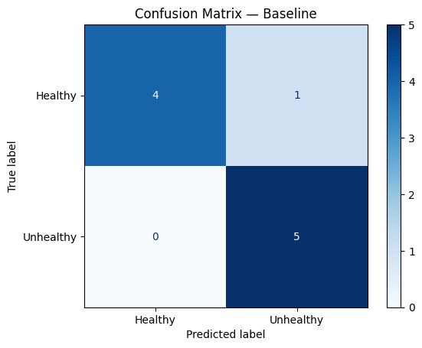
Krizhevsky, A., Sutskever, I., & Hinton, G. (2012). ImageNet Classification with Deep Convolutional Neural Networks (AlexNet).
PyTorch Documentation – Model Training and Data Loading.
Project Dataset (Healthy vs Unhealthy Grass Images).
Automated Grass Health Classification Using Alex Net Deep Learning Model
By Daniel Gutierrez
HYPOTHESIS
SUPPORTING DATA
CONCLUSION
If we train an Alex Net model using labeled images of healthy and unhealthy grass, then the model will be able to accurately classify new grass images based on color, texture, and pattern features, with an overall accuracy above 85%.
Model Performance Over Time:
The Training vs Validation Loss graph shows that both losses decreased significantly across the 10 epochs, with validation loss dropping sharply, indicating that the model quickly learned to generalize.
The Accuracy graph reveals that validation accuracy reached 90% early (Epoch 4) and consistently stayed around 88%–90%, while training accuracy gradually increased to 88%, showing strong generalization without severe overfitting.
Confusion Matrix – Baseline Evaluation:
Correctly predicted 4 out of 5 healthy images.
Correctly predicted all 5 unhealthy images.
Overall baseline accuracy = 90% (9/10 correct).
Hyperparameter Experiments:
Batch Size Test: Batch size of 64 achieved 100% accuracy, while batch size of 16 achieved 90%.
Learning Rate Test: Both 0.001 and 0.0001 produced 100% accuracy, but 0.001 learned faster.
Qualitative Results (Image Predictions):
Healthy predictions ranged from 81%–95% confidence.
Unhealthy reached up to 99.7% certainty.
Only one unhealthy image was misclassified as healthy (85.7%) due to green patches.
The Alex Net model successfully learned to classify grass health from images with up to 100% accuracy in hyperparameter experiments and strong validation performance (around 90% across the epochs). The model showed reliable predictions, correctly identifying critical visual features such as color richness, dryness patches, and texture density. These results confirm that deep learning is a strong approach for automating grass health detection. With more data and fine-tuning, this model could be used for real-world applications in smart irrigation, lawn maintenance systems, and agricultural monitoring.
BACKGROUND
The goal of this project was to develop an image classification model using Alex Net to detect whether grass is healthy or unhealthy. Detecting grass quality is important for landscaping, agriculture, irrigation planning, and early detection of soil or disease issues. The dataset contained clear visual differences between lush green grass and yellow/brown dry patches. By training an Alex Net model on these images, we measured how well the model could learn visual patterns that indicate health conditions.
REFERENCES
Krizhevsky, A., Sutskever, I., & Hinton, G. (2012). ImageNet Classification with Deep Convolutional Neural Networks (AlexNet).
PyTorch Documentation – Model Training and Data Loading.
Project Dataset (Healthy vs Unhealthy Grass Images).

